Slide 1
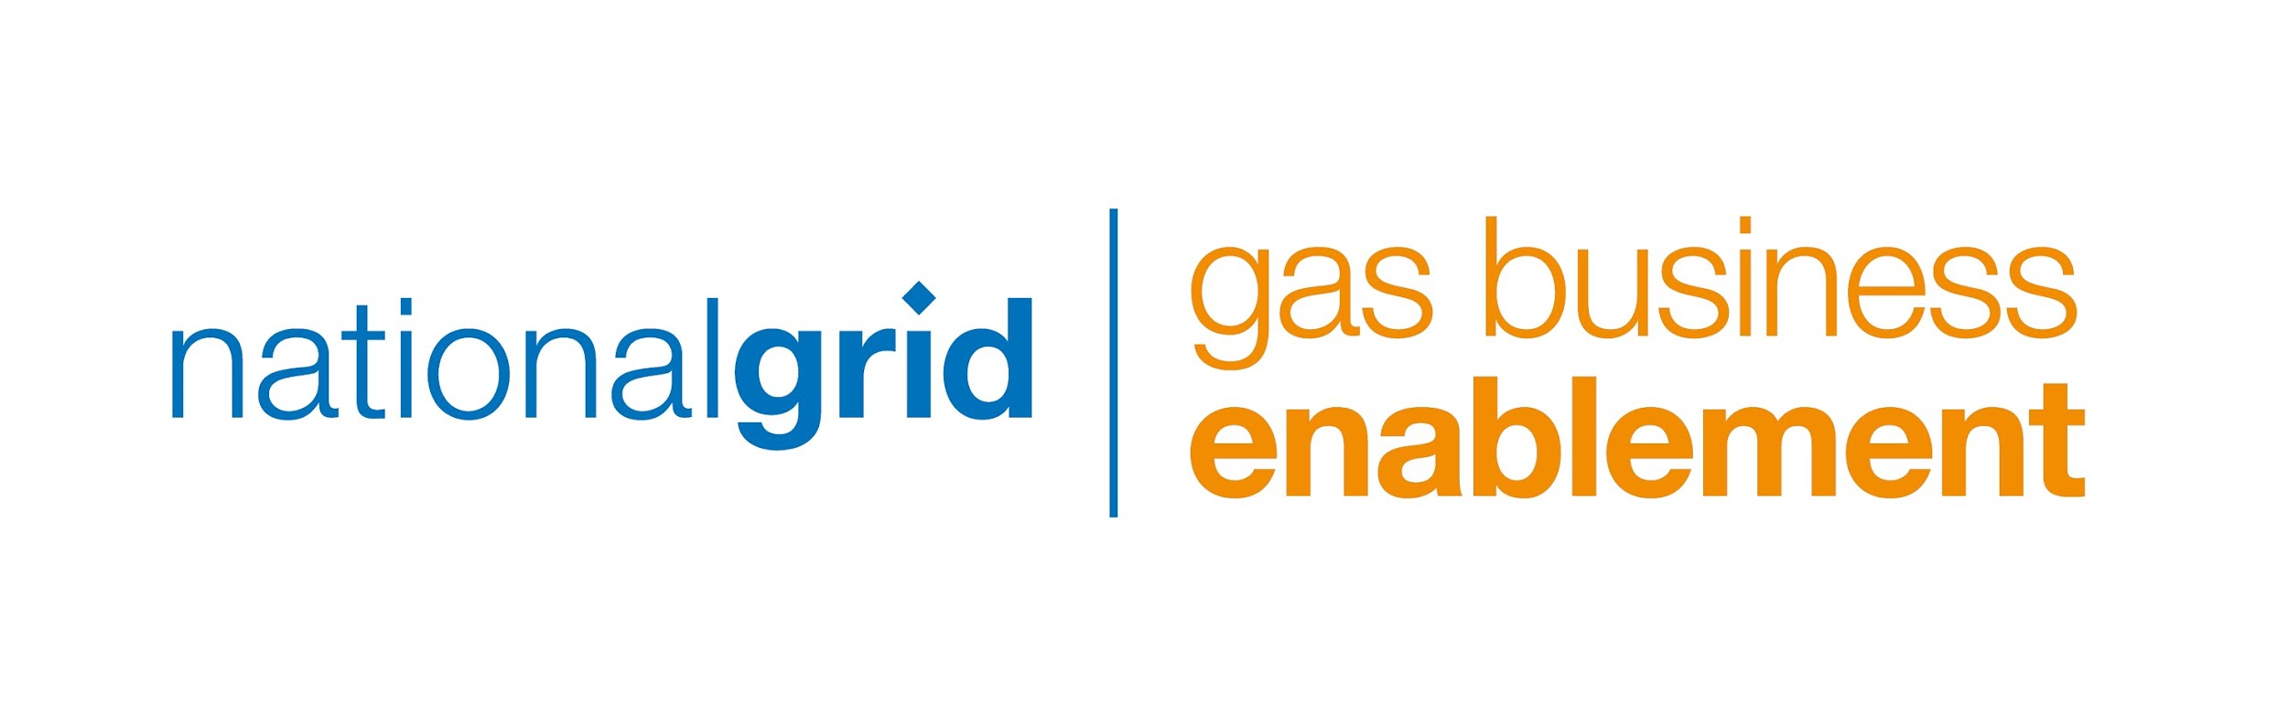
JULY 2019
CRIS- SF Data Model Design
INTERNAL USE ONLY
DRAFT

Slide 2

Overview
01

Slide 3
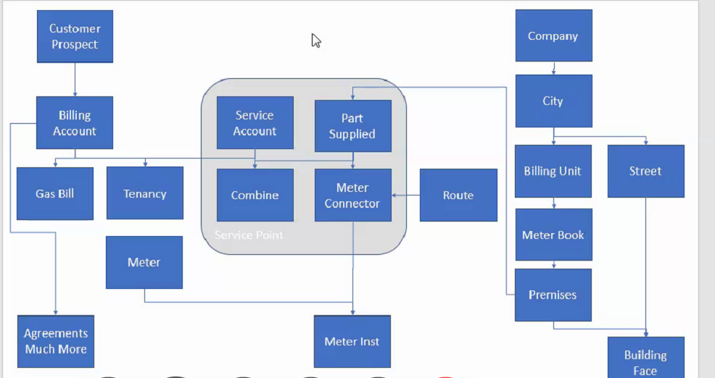
CRIS Data Model

Slide 4
CSS VS CRIS Data Model Comparison
CSS Data model (Core Objects)
Customer
Premise &
Parts Supplied
Billing Account
Service Point
Meter Point
Meter
Facts:
Premise will always have One active Billing Account.
Building structure and Parts supplied both are treated as Premise and they together form Premise Hierarchy
One Meter Point can have multiple meter associated to it.
i.e Billing Account can have multiple Meters associated.
Customer can have many Billing Accounts.
Salesforce Data model is Designed on CSS data model.
Prospect
Premise
CRIS Data model (Core Objects)
Service Point
Parts Supplied
Meter Connector
SA +combined
Meter
Billing Account
Facts:
One Premise can have Multiple Service Points and One Billing Account can have multiple Service points(Combined). So we have M: M relation between Billing Account and Premise.
Parts supplied are Attributes (Text value) of Service point and Unique field in Meter Connector for SP.
One Meter Connector will have i.e service point will have one Active Meter associated to it.
No Concept of Customer in CRIS so customer table.
Every Billing account will have One Meter
Customer can have multiple Billing Account.
Service point object is combination of Service Account +Combined Account+ Parts supplied + Meter Connector.

Slide 5
Salesforce Data Model Options
Customer
Option 1 (Existing SF Data Model)
Store Parts supplied as attribute of Asset object.
No Changes to SF Data model.
Service & Meter Points are attributes of Asset
Supports Combined Accounts functionality
Works for both CRIS & CSS
Recommended Option
No impact on CSS current implementation & Timeline
Premise
Billing Account
Assets
Service Point
Meter Point
(Parts Supplied)
Option 2 (Existing SF Data Model)
Create service Points as Premise and to display Parts supplied as Premise and form Hierarchy.
Asset will still have Service & Meter Points as Attributes.
No Changes to Data model in Salesforce.
No impact on current CSS implementation & Timeline
Combined Account functionality will not be supported.
Impact on Duplicate Data Storage & User Experience.
Complex Integrations and Data migrations.
Customer
Premise
Parts Supplied
Meter Connector
Service point
Billing Account
Assets
Service Point
Meter Point
Option 3 New SF Data model
Create a New Junction object between Premise & Billing Account
Works for both CRIS & CSS
Combined Account functionality will be supported.
Good Option if Projects to be started from scratch.
Huge Impact on current SF system .need to rebuild data model, Integrations,SF Codebase,Data migration, Testing ,Production system data .(Rebuild of system)
Need to do through impact on analysis .
Impact on Project timeline & Cost.
Customer
Premise
Billing Account
Billing Premise
(Service & Meter Point)
Assets
Meter Point

Slide 6
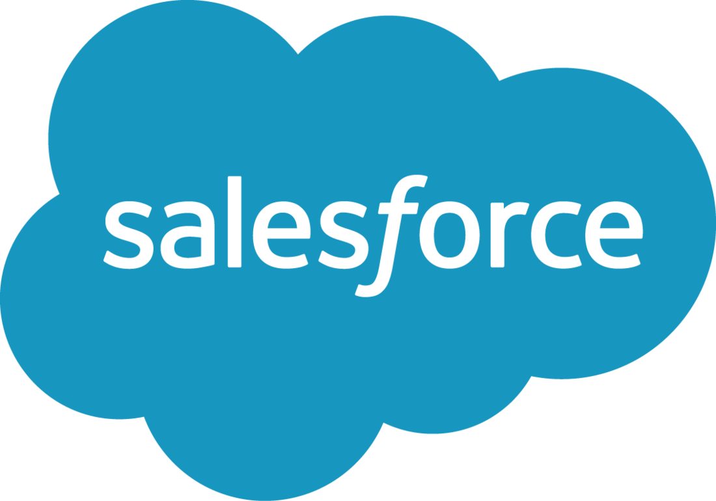
KDD: Data Model for CRIS Premises
Option 1: Service Point on Asset
Option 2:
Service Point on Premise(child)
Premise
Assets (Meters)
Premise
Child Premise (Service Point)
Assets (Meters)
Meter + Parts Supplied + Meter Connector
Parts Supplied (Meter Connector)
Meter
CRIS
Building
Building
Meter + Parts Supplied + Meter Connector
Parts Supplied (Meter Connector)
Meter
Meter + Parts Supplied + Meter Connector
Parts Supplied (Meter Connector)
Meter
 | Option 1 | Option 2
Data Model Consistency w/existing SF model | Yes | No
Integration Complexity | Complex | Complex
User Experience | Similar to CSS | Premise selection different from CSS
Data Migration Impacts | Similar to CSS | Complex association between service point and child premise
Supports Combined Accounts | Yes | No
Data Storage Requirements | No Impacts | Increased Premise Records
Notes:
Option1:
Pros:
Consistent Premise definition for CRIS and SF
Data Model consistency between Premise to Asset relationship
Can give Same user experience for CSR in SF
All Service Point information available on Asset object
Minimum number of Premise record & Meter records.
Combined Accounts will be supported
Cons:
Future
Option 2:
Pros:
Service Point/Meter Connector will be created as Child Premise, and CRIS Premise as Parent Premise
Meter Connector stays consistent through meter and customer changes.
Maintain Existing SF Data Model and Standard definitions in SF
Cons:
There are more Premise records than Asset records
Increases data storage needs
Complex Premise integration In & Out
Does not work for Combine Accounts
Service Point is created as Premise instead of Parts supplied
Asset object also needs Service point & Meter Point as attributes in Asset object

Slide 7
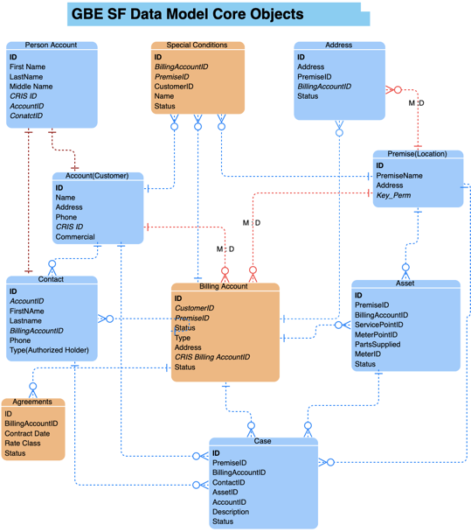

Slide 8
Appendix

